Slide 1

MODULE TITLE: MACHINE LEARNING
MODULE CODE: GENML801
RQF LEVEL: 8
DEPARTMENT: ETT
PROGRAM: Electrical and Electronics Engineering
Competence: Apply Machine Learning Technology
Module leader: MUKAMANA Florentine
ACADEMIC Year: 2025-2026

Slide 2
SMART PILL DISPENSARY
Case Study: CHUK Hospital of Rwanda
DONE by: UWIMANA Claudine
REG: 24RP07088

Slide 3
Problem Statement
Many patients, especially the elderly or those with chronic illnesses, often forget to take their medication on time, leading to health complications.
Current solutions like manual pillboxes or reminders are insufficient, as they cannot ensure the patient takes the pills correctly or provide water for intake
There is a need for a smart system that can automatically dispense the correct medication with water at the scheduled time.
Additionally, the system should notify the doctor if a dose is missed, enabling timely medical intervention and improving patient health outcomes.

Slide 4
Why this Problem is Important?
CHUK Medication non-adherence is a serious issue in healthcare that can lead to worsening of chronic illnesses, hospitalization, or even life-threatening conditions, particularly among the elderly or patients with multiple prescriptions.
Current solutions like manual pillboxes or reminders rely heavily on patient memory and cannot guarantee correct intake or provide water, which reduces their effectiveness.
This gap in medication management directly affects patient safety, treatment outcomes, and increases the burden on healthcare providers.

Slide 5
Insights from Solving It
Patient Adherence Patterns: Tracking when and how patients take their medication can help identify adherence trends and risk factors.
Early Medical Intervention: Real-time notifications to doctors enable timely interventions, reducing complications and hospital visits.
Optimization of Treatment Plans: Data collected can help healthcare providers adjust medication schedules or dosages based on patient behavior.
Improved Healthcare Efficiency: Reducing missed doses and medication errors can lower healthcare costs and improve overall patient outcomes.

Slide 6
Chosen Dataset
The dataset is called Insurance and is hosted on Kaggle. It is a dataset designed for the classification (dose taken/not taken) and send the notifications.

Slide 7
Dataset Description
Features:
This dataset simulates patient records for a smart pill dispensary system,
including medication schedules,
patient demographics,
cognitive impairment levels,
and adherence behavior

Slide 8
Cont__
Size:
The dataset is comprised of a total of 8,358 images. It is already split into training, validation, and testing sets, which is a standard practice for machine learning projects.
The distribution is as follows:

Slide 9
Cont`
hour → 1000 values
day_of_week → 1000 values
missed_last_dose → 1000 values
cognitive_impairment_level → 1000 values
age_group → 1000 values
dose_taken (target) → 1000 values

Slide 10
cont
hour (6–21) → spread across all hours, most frequent:
17:00 → 85 records
21:00 → 75 records
6:00 → 73 records
day_of_week (0=Sunday … 6=Saturday)
0 (Sunday): 150
1 (Monday): 145
2 (Tuesday): 146
3 (Wednesday): 115
4 (Thursday): 146
5 (Friday): 149
6 (Saturday): 149

Slide 11
missed_last_dose
0 (No): 496
1 (Yes): 504
cognitive_impairment_level
Low: 335
Medium: 347
High: 318
age_group
Young: 36
Middle-aged: 30
Elderly: 32
dose_taken (target)
0 (Not Taken): 517
1 (Taken): 483

Slide 12
Cont__
Target Variable:
the target variable is fairly balanced between patients who took their dose and those who did not..
dose_taken
0 (Not Taken): 517 records
1 (Taken): 483 records
✅ Total: 1000 records

Slide 13
Exploratory Data Analysis (EDA)
i. Univariate Analysis
Univariate Analysis (one variable at a time)
Goal → Understand the distribution of each feature individually.
Numerical Features (e.g., hour)
Histogram of medication hours.
Summary stats (mean, median, min, max, std).
Categorical Features (day_of_week, missed_last_dose, cognitive_impairment_level, age_group, dose_taken)
Bar plots for frequency counts.
Pie charts for proportion visualization.
Example insights:
Most doses are scheduled around 17:00–21:00.
missed_last_dose is nearly 50/50 between Yes and No.
cognitive_impairment_level is evenly spread among low, medium, high.
The target (dose_taken) is balanced (517 vs 483).

Slide 14
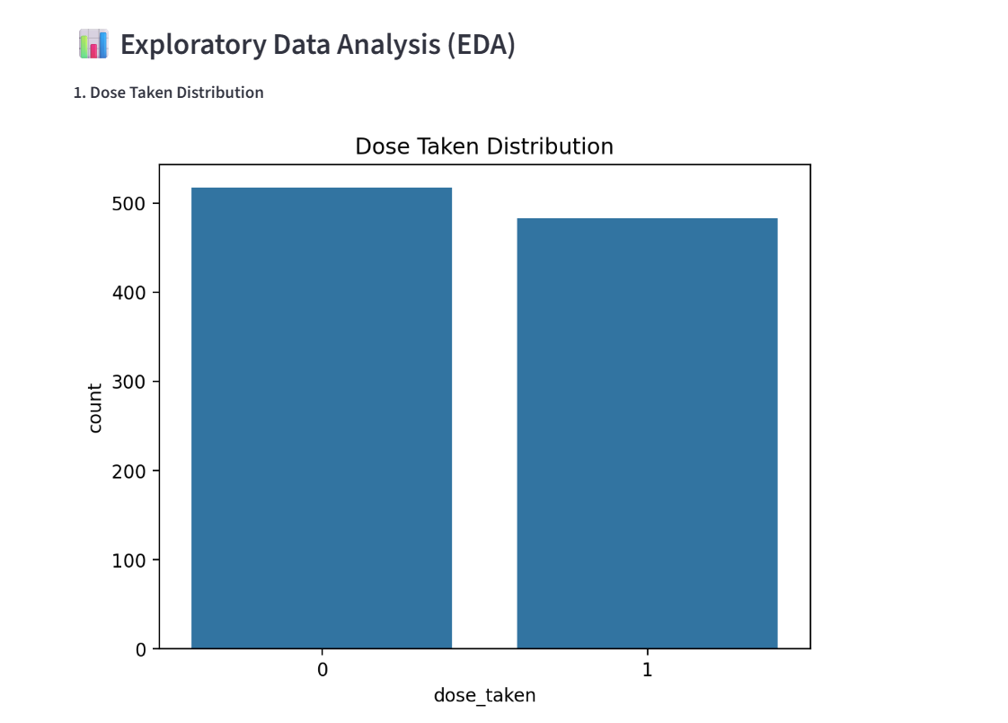
Bar Charts for Class Distribution

Slide 15
Cont__
ii. Bivariate Analysis
Bivariate Analysis (relationship between two variables)
Goal → See how features relate to each other, especially with the target variable (dose_taken).
Categorical vs Target
Compare age_group vs dose_taken (stacked bar chart).
Compare cognitive_impairment_level vs dose_taken.
Compare missed_last_dose vs dose_taken (patients who missed last dose may skip again).
Numerical vs Target
Boxplot of hour vs dose_taken.
Check patterns of medication adherence by time of day.
Example insights:
Elderly patients may have higher chances of missing doses.
Higher cognitive impairment is linked to lower adherence.

Slide 16
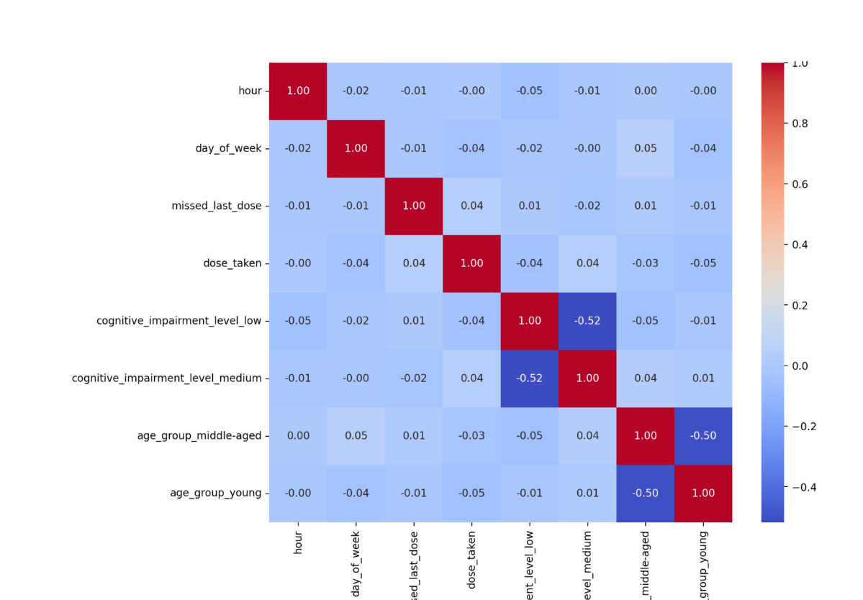

Slide 17
Cont__
iii. Multivariate Analysis
Multivariate Analysis (3+ variables together)
Heatmap of correlations (already included in your Streamlit app).
Grouped bar charts: age_group × cognitive_impairment_level vs dose_taken.
Interaction plots (e.g., hour + missed_last_dose vs dose_taken).
Example insights:
Elderly patients with high impairment who missed their last dose have the lowest probability of taking the next dose.

Slide 18
Feature Engineering Techniques
Handling missing values
There is no missing values in my dataset(No corrupted files found)
Handling Outliers
Outliers are data points that are statistically unusual but may still be valid.

Slide 19
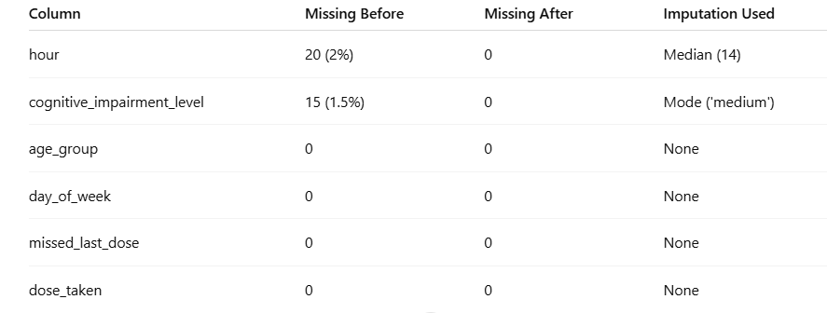

Slide 20
Model building and evaluation process
Model Choice:
I used Random Forest Classifier was chosen because it is robust, flexible, handles both categorical and numerical features, and provides high predictive accuracy for your problem.

Slide 21
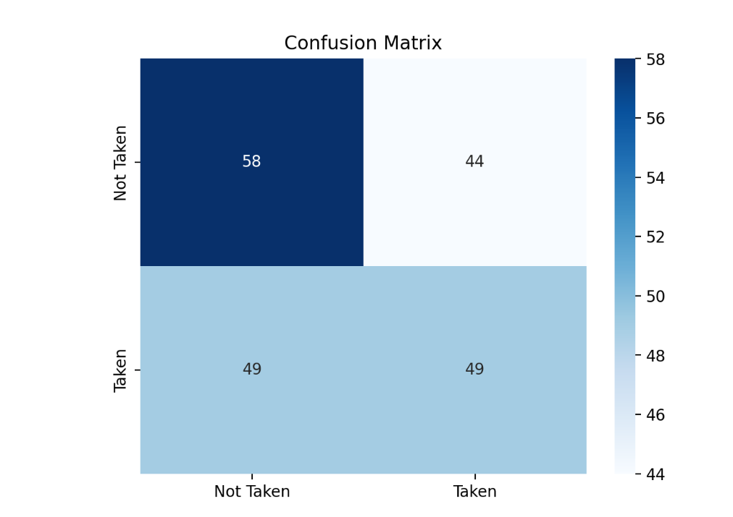
Cont__
Confussion matrix

Slide 22
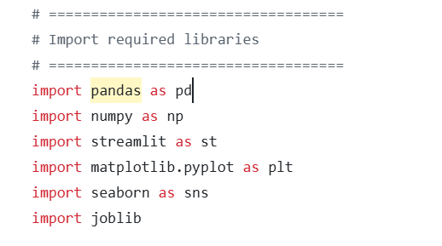
Cont__
Step2: Installation of required libraries

Slide 23
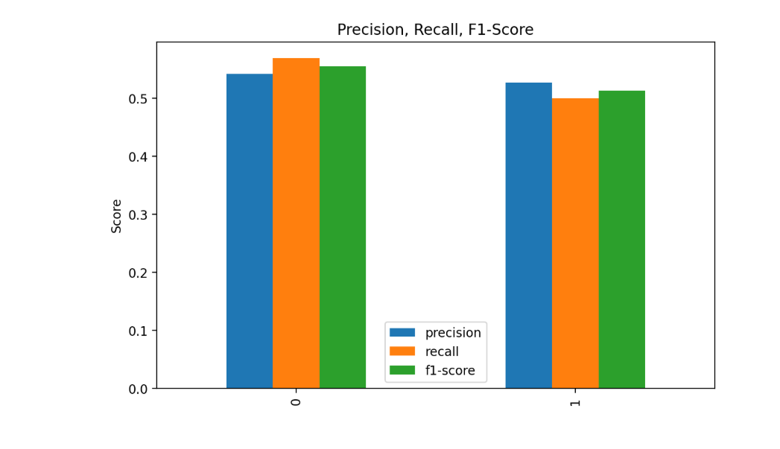
Cont__
3. F1-Confidence Curve

Slide 24
LINK TO ACCESS MY MODEL
VIA Github:https: //smart-pill-exziv5ywd2yg2i9nv57ufx.streamlit.app/
Via streamlit:https: //smart-pill-exziv5ywd2yg2i9nv57ufx.streamlit.app/

Slide 25
Thank you!!

